Slide 1
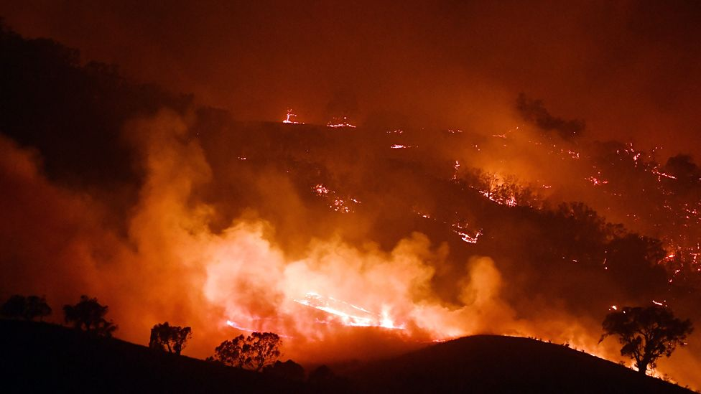

Presented by :Agent-based pizza
Agent Based Modelling
Forest Fire Spreading and Extinguishing

Slide 2
Research Motivation :
Recent events of forest fires in Australia
Criticism on response of Australian government
Research Question :
Which strategies of firefighters are more effective for reducing the forest fire spread and damage?

Slide 3
Attributes of Environment
Attributes | Parameters | Ranges
Space | width/height | [20, 100]
Probability of fire spreading | fire_spread_param | [0.003, 0.006]
Number of Firefighters | number_firefighters | [0, 20]
Density (beta distribution) | initial_distribution_alpha | 1.5
 | initial_distribution_beta | 10
 | max_density | 555
Fireforest(Model)

Slide 4

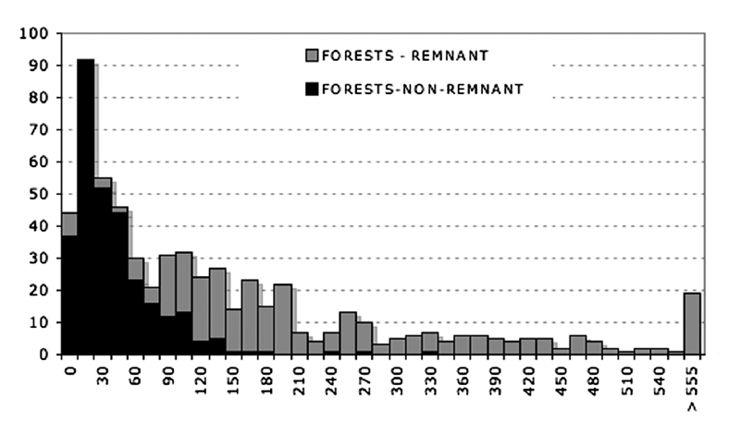
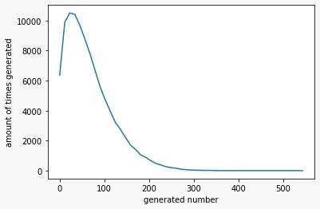
Environment
DENSITY:
For the whole grid, initialize each cell’s density randomly based on BETA DISTRIBUTION*
An Evaluation of the ALOS PALSAR L-Band Backscatter—Above Ground Biomass Relationship Queensland, Australia:
Impacts of Surface Moisture Condition and Vegetation Structure

Slide 5
Attributes of Trees
Attributes of each cell | Parameters | Ranges
Position | pos
Biomass | density | [0, 555]
State of burning | on_fire | Boolean
Tree Agent

Slide 6
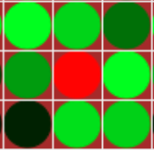
Agents
Actions
SPREAD FIRE:
A central burning cell can spread fire to 8 neighboring cells in the Moore neighbourhood.
For any neighboring cell i, the probability of catching fire is:
P_{C}(i)=neighbors[i].density × fire_spread_parameter
example: P_{C}(i) = 100 * 0.005 = 0.5

Slide 7





Low density
Medium density
High density
On fire
Burned
5 steps
13 steps
16 steps

Slide 8

Attributes of Firefighters
Attributes | Parameter | Ranges
Position | pos
Strategy | strategy | “extinguish” or “firelines”
Response delay | response_delay | [1, 5]
Difficulty to extinguish trees | extinguish_difficulty | [1, 5]
Distance from fire to start firelines | fire_line_margin | [1, 5]
Amount of density able to remove for fireline | cut_down_amount | [100, 555]
Firefighter Agent

Slide 9
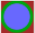
Agents
Strategy 1 : Set Firelines
Strategy 2: Distinguish fires

Slide 10
Agents
Actions
Strategy 1 : Set Firelines
Response delay
Start by cutting down dense/high risk areas first
Continue until fire is gone or all trees are cut
If all trees are cut, but fire escaped the firelines before completion, repeat from step 2

Slide 11
Agents
Actions
Strategy 2 :Extinguish fire
Wait for some time steps to simulate response delay
Move to tree with highest density that is on fire
Try to extinguish it, success is probabilistic based on extinguish_difficulty parameter
While trees are on fire repeat from step 2

Slide 12
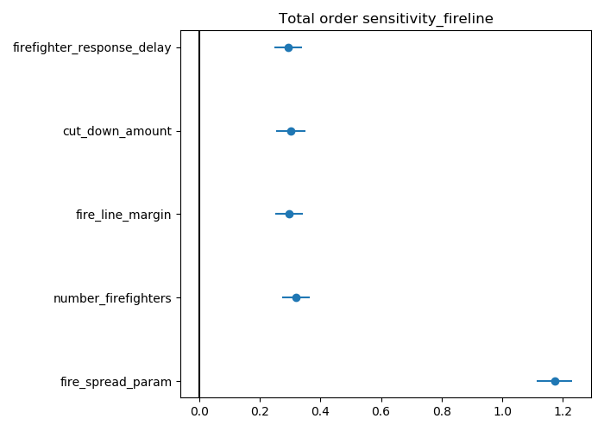
Agents
Agents
Sensitivity Analysis
Total-Order-Sensitivity of
Analysis result
Strategy 1. Set Firelines
“ fire_spread_param “ is the MOST SENSITIVE parameter in strategy 1.

Slide 13
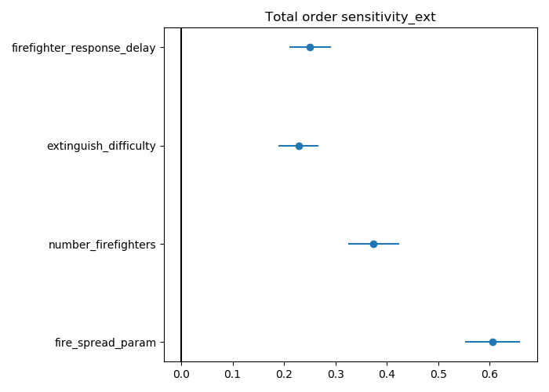
Agents
Agents
Sensitivity Analysis
Total-Order-Sensitivity of
Analysis result
Strategy 2. Extinguish Fires
“ fire_spread_param “ is the MOST SENSITIVE parameter in strategy 2.
“ fire_spread_param” is the most sensitive parameter for BOTH strategies ！！！

Slide 14
Simulation results!

Slide 15
Result
Basic parameters:
number_firefighters = 10
extinguish_difficulty = 2
firefighter_response_delay = 2
number_firefighters = 10
cut_down_amount = 200
fire_line_margin = 5
firefighter_response_delay = 2

Slide 16
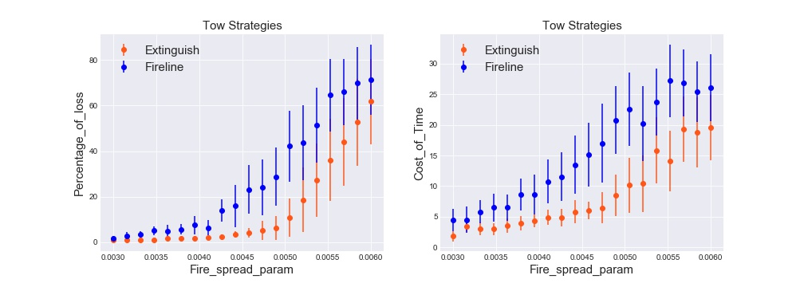
Result
Percentage of forest loss and cost time change with various Fire_spread_param
Both percentage of forest loss and cost time increase when fire_spread_param increases.

Slide 17
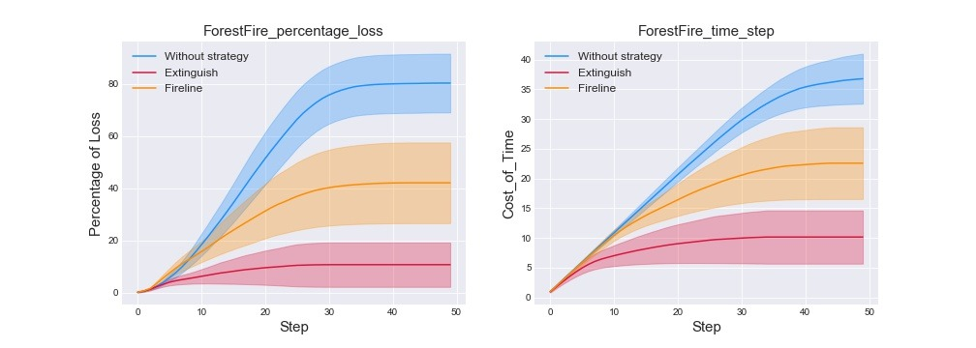
Result
When : Fire_spread_parameter=0.00505263, number of firefighter=10

Slide 18
Conclusion
Agent-based model is effective to simulate the spreading of forest fires.
Among all the parameters, fire spread rate is the most important in this model.
Extinguishing is the most effective strategy.

Slide 19
Limitation
Wind and other factors were not implemented in this model.
There are preventative measures we did not explore.
Thinning the forest
Starting deliberate fires

Slide 20
Future Steps
Adding wind to the model
Add terrain like water, road, building and hills/mountains
Explore more strategies for the firefighters

Slide 21
QuestionS?
Thanks!

